Slide 1
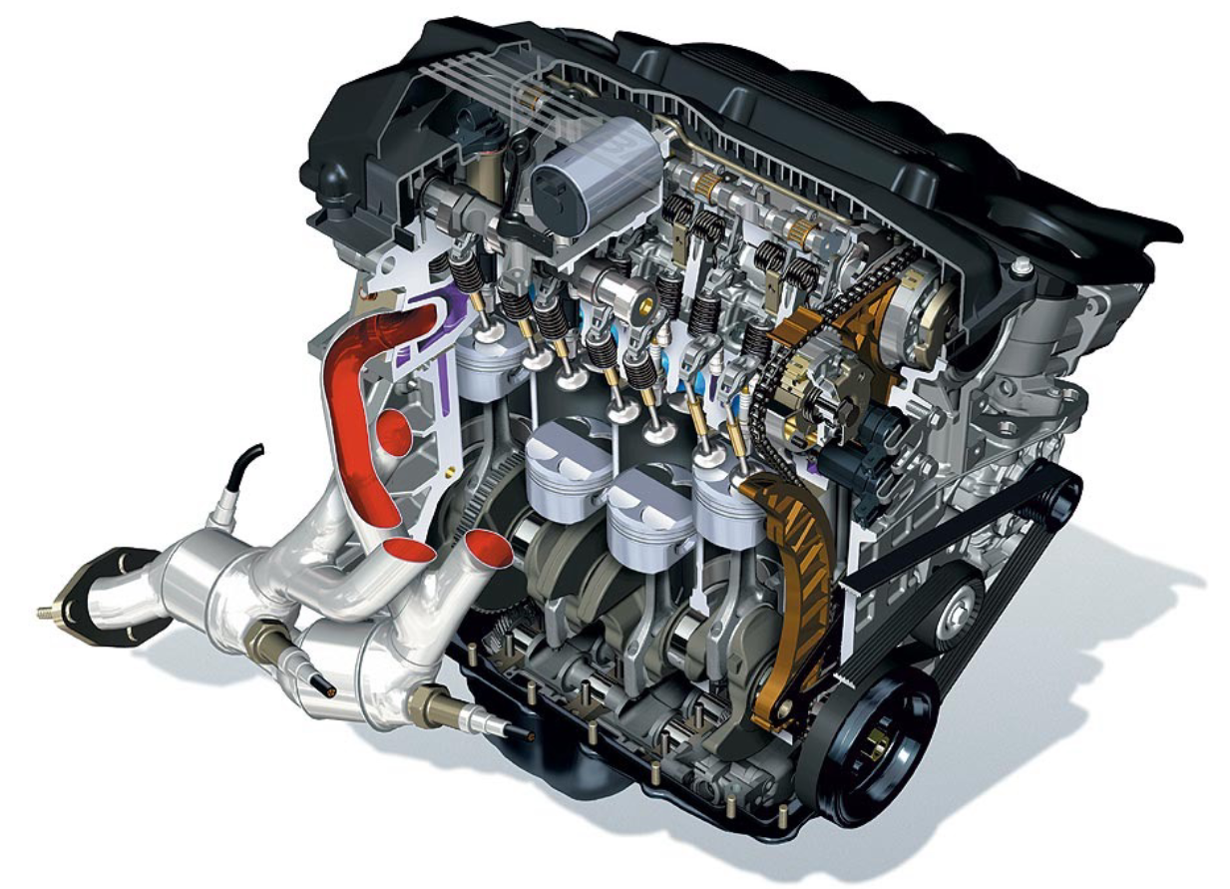
Engines and Fuel cells
Exercise ENG0

Slide 2
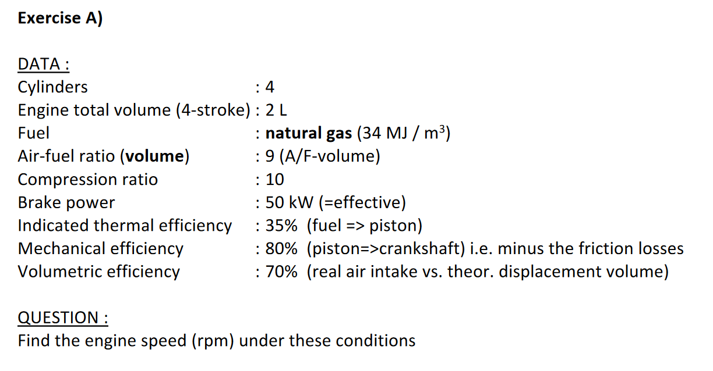
Exercise ENG0: Power System of a vehicle
Reference:
1. Formula Memento, Page 2
2. Lecture 1, page 25-26

Slide 3
Exercise ENG0: Power System of a vehicle
Engine speed in cycle/s
Power per cylinder
Power per cycle
Thermal input power
Fuel energy
Indicated power
Air intake
Brake power

Slide 4
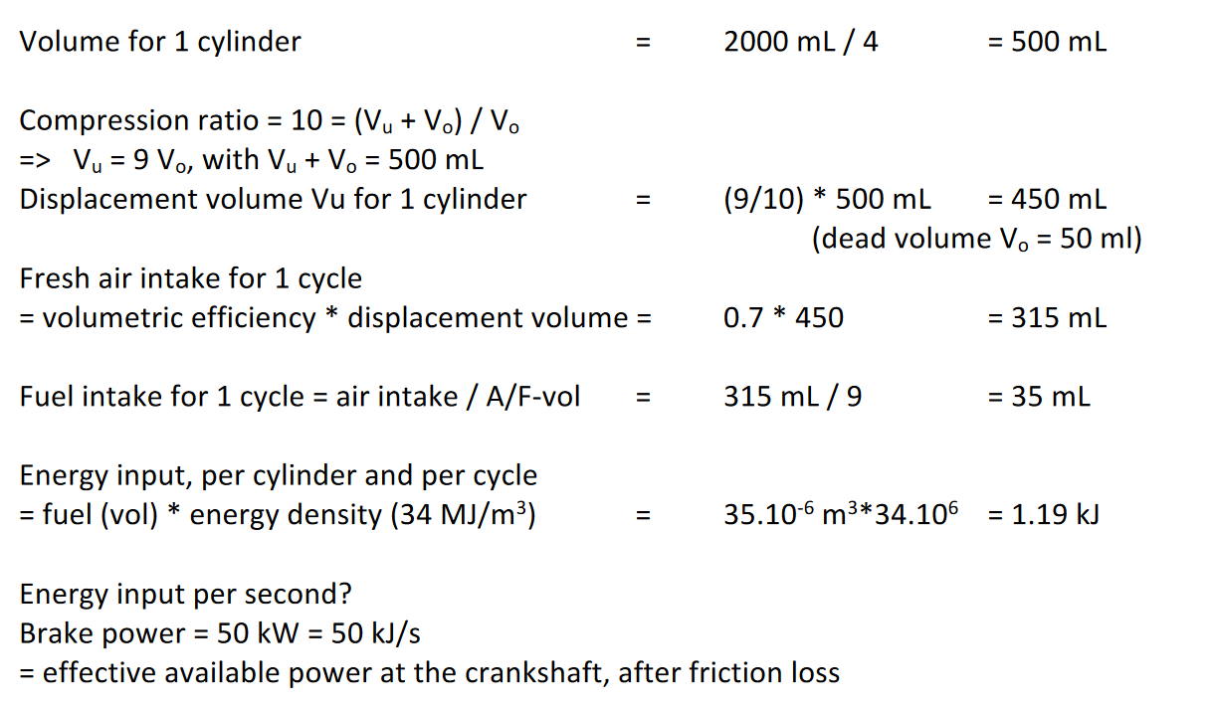
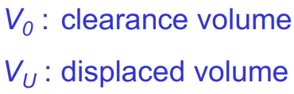
Exercise ENG0: Power System of a vehicle
Engine speed in cycle/s
Power per cylinder
Power per cycle
Thermal input power
Fuel energy
Indicated power
Air intake
Brake power

Slide 5
Exercise ENG0: Power System of a vehicle
Engine speed in cycle/s
Power per cylinder
Power per cycle
Thermal input power
Fuel energy
Indicated power
Air intake
Brake power

Slide 6
Exercise ENG0: Power System of a vehicle
Engine speed in cycle/s
Power per cylinder
Power per cycle
Thermal input power
Fuel energy
Indicated power
Air intake
Brake power

Slide 7
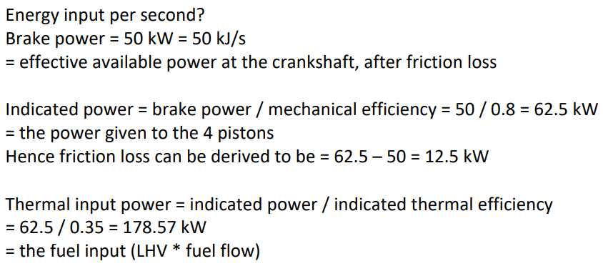
Exercise ENG0: Power System of a vehicle
Engine speed in cycle/s
Power per cylinder
Power per cycle
Thermal input power
Fuel energy
Indicated power
Air intake
Brake power

Slide 8
Exercise ENG0: Power System of a vehicle
Engine speed in cycle/s
Power per cylinder
Power per cycle
Thermal input power
Fuel energy
Indicated power
Air intake
Brake power

Slide 9
Exercise ENG0: Power System of a vehicle
Engine speed in cycle/s
Power per cylinder
Power per cycle
Thermal input power
Fuel energy
Indicated power
Air intake
Brake power
4 cylinders!

Slide 10
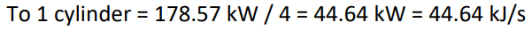
Exercise ENG0: Power System of a vehicle
Engine speed in cycle/s
Power per cylinder
Power per cycle
Thermal input power
Fuel energy
Indicated power
Air intake
Brake power

Slide 11
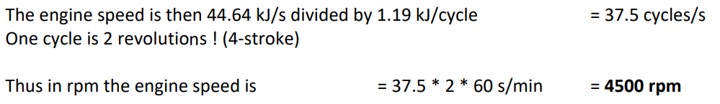
Exercise ENG0: Power System of a vehicle
Engine speed in cycle/s
Power per cylinder
Power per cycle
Thermal input power
Fuel energy
Indicated power
Air intake
Brake power

Slide 12
Exercise ENG0: Power System of a vehicle
What about the reality?
37.5 cycles per second per cylinder
Fuel consumption: 0.035×37.5×4=5.25 L/s = 315 L/min = 18.9 m³/h
Energy consumption: 18.9 m³/h × 34 MJ/m³ = 642.6 MJ/h
Equivalent gasoline consumption: 642.6 MJ/h ÷ 32 MJ/L ≈ 20 L/h
4500 rpm + 50 kW brake power → 150 km/h (rough estimation)
Gasoline consumption per 100 km: 20 L/h ÷ 1.5 (100km/h) = 13.3 L/(100km)
Generally, the gasoline consumption is about 8-9 L/(100km), the result is logically higher.

Slide 13
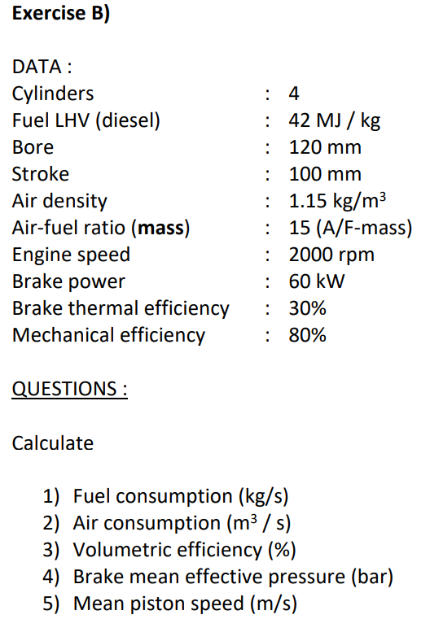
Exercise ENG0: Power System of a vehicle
Reference:
1. Formula Memento, Page 2-4

Slide 14
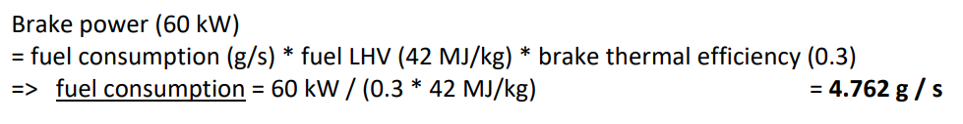
Exercise ENG0: Power System of a vehicle
Brake power
Brake thermal efficiency
Fuel LHV
Fuel consumption

Slide 15
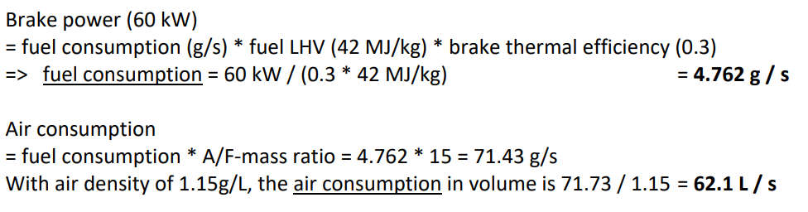
Exercise ENG0: Power System of a vehicle
Brake power
Brake thermal efficiency
Fuel LHV
1) Fuel consumption 4.762 g/s
A/F-mass ratio
2) Air consumption

Slide 16
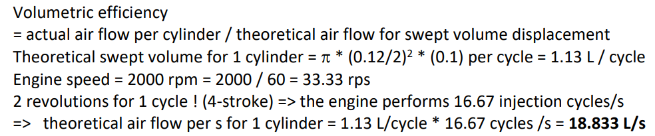
Exercise ENG0: Power System of a vehicle
Brake power
Brake thermal efficiency
Fuel LHV
1) Fuel consumption 4.762 g/s
A/F-mass ratio
Cylinder volume
Engine speed
2) Air consumption 15.53 L/s
Theoretical air flow
3) Volumetric efficiency

Slide 17
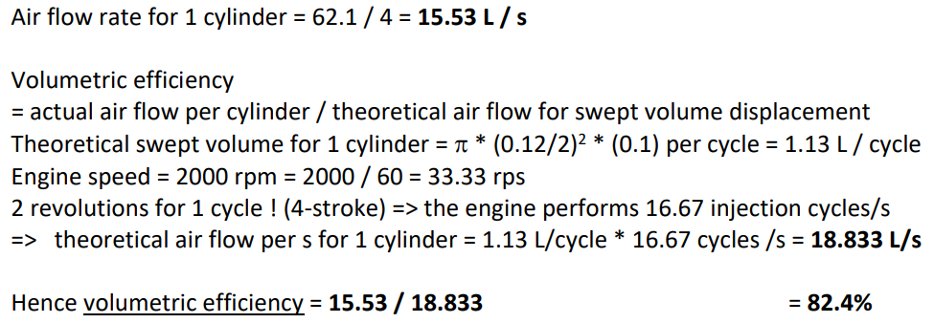
Exercise ENG0: Power System of a vehicle
Brake power
Brake thermal efficiency
Fuel LHV
1) Fuel consumption 4.762 g/s
A/F-mass ratio
Cylinder volume
Engine speed
2) Air consumption 15.53 L/s
Theoretical air flow 18.833 L/s
3) Volumetric efficiency

Slide 18
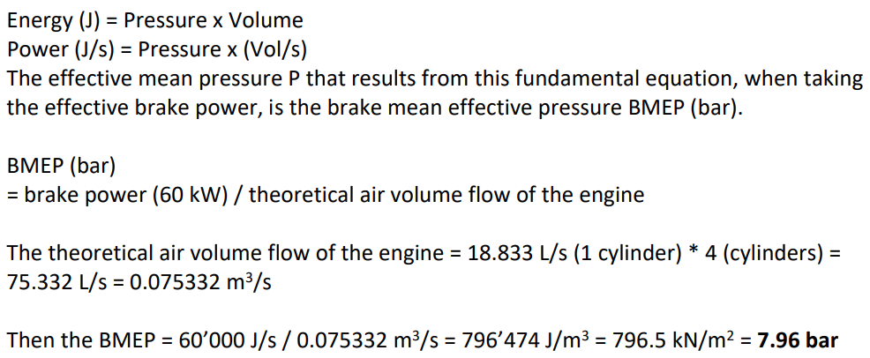
Exercise ENG0: Power System of a vehicle
Brake power
Brake thermal efficiency
Fuel LHV
1) Fuel consumption 4.762 g/s
A/F-mass ratio
Cylinder volume
Engine speed
2) Air consumption 15.53 L/s
Theoretical air flow 18.833 L/s
3) Volumetric efficiency 82.4 %
4) BMEP
Brake power

Slide 19
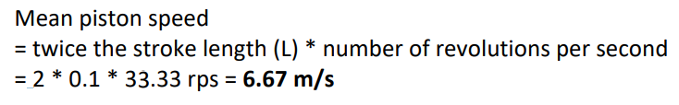
Exercise ENG0: Power System of a vehicle
Brake power
Brake thermal efficiency
Fuel LHV
1) Fuel consumption 4.762 g/s
A/F-mass ratio
Engine speed
2) Air consumption 15.53 L/s
3) Volumetric efficiency 82.4 %
4) BMEP 7.96 bar
5) Mean piston speed

Slide 20
Exercise ENG0: Power System of a vehicle
What about the reality?
Fuel consumption: 4.762 g/s=285.7 g/min = 17.14 kg/h
2000 rpm + 60 kW brake power → 120 km/h Diesel jeep or buses or trucks
Diesel consumption: 17.14 kg/h ÷ 0.85 kg/L = 20.16 L/h
Diesel consumption per 100 km: 20.16 kg/h ÷ 1.2 （100km/h）= 16.8 L/(100km)
This is realistic for a 4.5 L jeep.

Slide 21
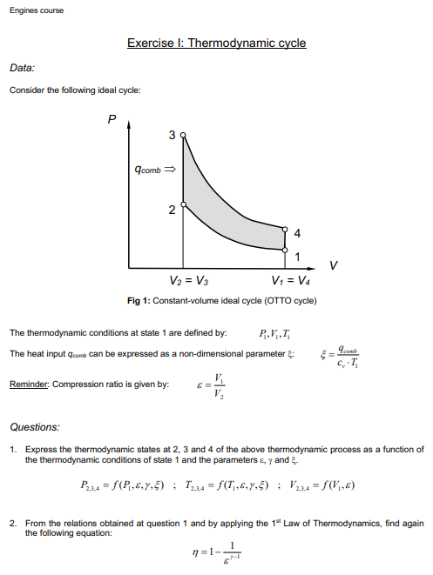
Exercise ENG1: Thermodynamic cycle
Notes:
Today we will explore a fundamental concept in thermodynamics: the Otto Cycle, which is the idealized cycle used in many internal combustion engines, particularly gasoline engines. The exercise focuses on understanding the relationship between various states in the cycle and how thermodynamic laws apply to it.
Overview of the Otto Cycle
The Otto Cycle consists of four processes, represented in the Pressure-Volume (P-V) diagram:
Process 1-2: Adiabatic compression (no heat exchange, just compression of the working fluid)
Process 2-3: Constant-volume heat addition (where combustion occurs, adding heat to the system)
Process 3-4: Adiabatic expansion (the system expands, performing work)
Process 4-1: Constant-volume heat rejection (cooling the system down to complete the cycle)
Adiabatic Processes: No heat is exchanged with the surroundings, and the relationship between pressure, volume, and temperature follows specific laws.
Constant-Volume Processes: Heat is added or removed while the volume remains unchanged.
Efficiency: The efficiency of the Otto cycle is directly related to the compression ratio, which affects the overall performance of the engine.
This exercise will deepen your understanding of how engines convert heat into mechanical work and provide you with a framework for analyzing real-world thermodynamic systems.
Take your time, and feel free to ask questions as we explore the details of the Otto cycle!

